Slide 1
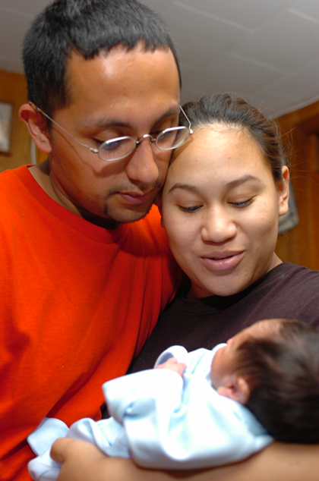
ILLINOIS
EARLY LEARNING
GUIDELINES For Home Visitors
(Trainer’s Manual)
WELCOME!

Slide 2
Notes to the Trainer
Using this PowerPoint File
Audience
Maximum Attendees
Dividing the Training Session
Materials
Gateways Registry Approval
Members and Non-members
Forms, Supplements, and Applications
How to Become a Registry-Approved Trainer
Notes:
Illinois Early Learning Guidelines (IELG) Trainer Notes:
Instructions for Using this PowerPoint file:
Now that you’ve completed the Illinois Early Learning Guidelines Train-the-Trainers course, you are ready to conduct your own training sessions with home visitors.
Use this PowerPoint presentation and the notes here in the notes area to guide the preparation and delivery of this 4-hour workshop.
This training is designed for groups, ideally, of up to a maximum of 25-30 attendees.
It can be divided as needed into two 2-hour sessions. You know best the logistical needs and constraints of your group of home visitors and are in the best position to ensure this training is well received. The following notes are provided to help you plan and conduct this 4-hour session.
You will need internet access, a computer or notebook, a projector, flip chart paper, and a projector screen. Should finding an internet connection be a challenge, download the three (3) videos necessary for this training from the IELG Trainer Forums site at http://opfibti.org/ielgforums/. In the side-bar on the right side, click on the Quick Link, “IELG Training Materials” and download the webinar and videos for your specific training onto a flash drive.
Materials:
Each participant should receive at the beginning of this training:
1 Participant ‘s Guide and Resource Toolkit (which is a copy of this PowerPoint with notes and the Resource Toolkit section in the back of the guide)
2 Observation Worksheets for each participant for use in viewing videos
1 Action Plan form
1 Illinois Early Learning Guidelines (IELG) Book or a ratio of 1 IELG book to every 3 attendees (for use in the small group and video observations)
Pens; post-it notes to record “Parking Lot” questions
Gateways to Opportunity - Registry Approval:
The Illinois Early Learning Guidelines Training is part of the ExceleRate Illinois Curriculum, and as part of ExceleRate, must be Gateways registry-approved.
Participants attending your Illinois Early Learning Guidelines (IELG) training will only receive Registry credit if your training is Registry-approved. If you are approved as a Registry trainer, you will need to schedule your IELG trainings through Gateways/INCCRRA and submit Gateways sign-in sheets within 10 days following the training.
In order to train for Registry credit you must do one of the following:
If currently a Registry Member:
Submit an Information Update Form
Submit a Trainer Supplement
Submit a Training Application for IL Early Learning Guidelines
These must all be submitted together
If not a Registry Member:
Submit a Registry Member Form
Submit a Trainer Supplement
Submit a Training Application for IL Early Learning Guidelines
These must all be submitted together
All forms, supplements and applications can be found and downloaded here from the Gateways to Opportunity website: http://www.ilgateways.com/en/participant-application
Information on how to become a Registry-approved trainer, as well as applications, may be found on the Gateways to Opportunity website www.ilgateways.com. For questions, please contact Sara Vore at svore@inccrra.org or 866-697-8278.

Slide 3
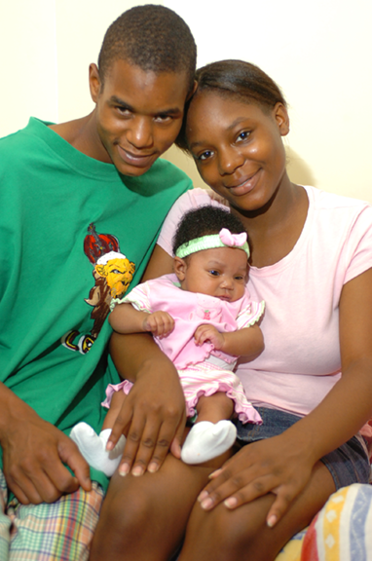
ILLINOIS
EARLY LEARNING
GUIDELINES For Home Visitors
WELCOME!
Notes:
Illinois Early Learning Guidelines (IELG) Trainer Notes: (Please show this particular slide prior to the session and as session starts) 4 minutes
Script:
“Welcome to the Illinois Early Learning Guidelines Training for Home Visitors. You are among hundreds of those attending this training across the state because you provide support and early learning experiences for parents and their children from birth to three years of age.”
Instructions:
Ask the following questions by raise of hands.
Script:
“Who is already using the Illinois Early Learning Guidelines in their work with children?”
“Who has received a copy and at least has reviewed its content?”
“For whom is this a first or near first opportunity to get to know its contents and how to use it in your setting?”
Instructions:
After everyone has answered the questions by raising their hands acknowledge the range of experiences in the room and how we can learn from each other, or that the group is roughly at the same starting point.
Script:
“Great! Let’s take a look at how we will spend the four hours we have allotted for this training. While we’ve allotted 4 hours for this training, it can be divided into two 2-hour sessions.”

Slide 4
IELG Agenda
Welcome and Introductions
Illinois Standards Orientation
Introduction to the Illinois Early Learning Guidelines (IELG)
IELG in Action
Practice!
Guidelines in Action Summary
Resource Toolkit
Action Plan
Reflection and Evaluation
Notes:
IELG Trainer Notes: 2 minutes
Script:
“This training is your opportunity to learn about the Illinois Early Learning Guidelines, given your role as a home visitor, to think through how you will embed the Guidelines into the services you provide to families.
Here is how we will use the 4 hours we have together.”
Instructions: Please read the agenda.

Slide 5
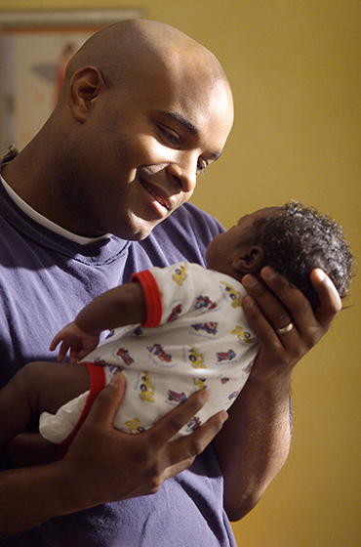
Introductions Activity
Name
Role
Identify a wish you have for the future of a child between the ages of birth to three and their family.
Notes:
IELG Trainer Notes: 4 Minutes
Script:
This activity will ground us as we focus on “Why we do what we do.” Let’s get to know a little bit about some of the people in this room.
Instructions for the Introductions Activity:
Ask attendees to form groups of three (turn their chairs around) and share with each other their name, role and a wish they have for the future of a child between the ages of birth to three and their family . Each person gets one minute. Tell the group you will keep time and give 1 minute shout-outs to keep conversations going, At the end, comment to the group observations about the “energy in the room,” how lively the conversation was, and call out other observations that members of your group have made.
Script:
“The future of children and families is “about the incredible difference WE can make” is why we are here today. What happens during this training today, begins with us, influences the parents and children, and impacts the outcomes of every child!
Let’s look at our learning objectives.”

Slide 6
Learning Objectives
As a result of participation in this 4-hour training, home visitors will:
Become aware of the history, purpose and role of the Illinois Early Learning Guidelines in the context of Illinois Learning Standards.
Develop a working knowledge of the Illinois Early Learning Guidelines, and Resource Toolkit.
Develop plans for the implementation of the Illinois Early Learning Guidelines in planning and daily routines of interaction with children and families.
Notes:
IELG Trainer Notes: 2 minutes (optional):
Instructions:
Post a flip paper “Parking Lot” to record questions that arise during the training for addressing in the course of the training or in follow up.
Ask if there are any questions.
Script:
“In short, we are here to learn what the Illinois Early Learning Guidelines are for birth to three and how to use them in our everyday work with children and families. So, we will spend the majority of our time on learning objectives 2. and 3.
Let’s take a look at our learning objectives for this training. Home visitors will:
Become aware of the history, purpose and role of the Illinois Early Learning Guidelines in the context of the Illinois Standards
Develop a working knowledge of the Illinois Early Learning Guidelines, resources and toolkit, and
Develop plans for the implementation of the Illinois Early Learning Guidelines in planning and daily routines of interaction with families and their children.
I mentioned at the beginning of this program that we are among hundreds of birth to three providers taking this training on the Illinois Early Learning Guidelines. The context of this training and our work in birth to three is part of a much larger initiative and effort in Illinois. Next we will watch a 15-minute webinar presentation that will orient us to the continuum of standards for learning that we have in Illinois for our children from birth to high school graduation.

Slide 7
Illinois Standards Orientation
Birth – Grade 12
http://youtu.be/GndC_UQ-TnA
Notes:
IELG Trainer Notes: 20 minutes
Instructions:
Watch the video “Webinar: Illinois Standards Orientation”. When the video has finished playing, process the trainee’s reactions.
Script:
“As you can see, the work we will be doing today is the very first important layer in providing quality early educational experiences to children and families in Illinois.”

Slide 8
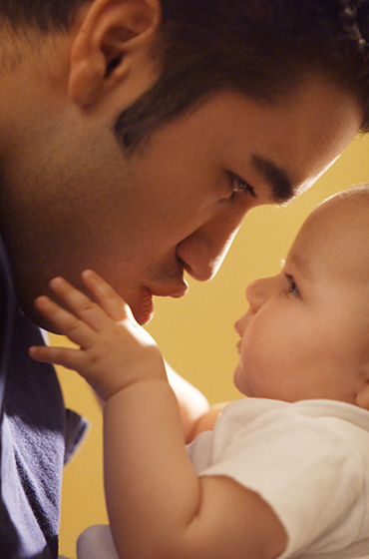
Introduction to the Illinois Early Learning Guidelines
History and Development
Purposes
Beliefs about Children and Development
What the Guidelines are not
Notes:
IELG Trainer Notes: 1 minute
Instructions:
Please read the script, then this slide.
Script:
“I hope that you take away from this presentation a renewed respect for the incredible role each of us and our staff play in supporting parents in launching children from their first early years onto a solid path for success. To finish our orientation to the Illinois Learning Standards and the Illinois Early Learning Guidelines, we will cover the following before getting into the book itself.
History and Development
Purposes of the Illinois Early Learning Guidelines
Beliefs about Children and Development, and
What the Guidelines are not.”

Slide 9
History and Development of Guidelines
Statewide Collaboration
Illinois Early Learning Council
Infant Toddler Committee
IELG Work Group
IELG Domain Writing Team
Notes:
IELG Trainer Notes: 2 minutes
Instructions:
Ask your participants:
Script:
“Did anyone here participate in the development of the Illinois Early Learning Guidelines? (If yes, ask when and how they were involved.)
The webinar we watched of the Illinois Standards Orientation presented some of the history of the development of the Illinois Early Learning Guidelines. What’s important to know is that the development of the Guidelines was a collaborative process over a two-year period of time with many people involved.”
Instructions:
Please read the slide:
Script:
“This was a Statewide Collaboration made up of
The Illinois Early Learning Council,
Infant Toddler Committee,
Illinois Early Learning Work Group, and
Illinois Early Learning Guidelines Domain Writing Team.
When President Obama signed Race to the Top into law, Illinois became one of 20 states who received funds to continue it’s work to advance early learning. Today, the Race to the Top funding is being distributed by the Illinois Governor’s Office of Early Childhood Development which also oversees its implementation in programs. This training is funded by those dollars to be sure that program leaders, family child care, center-based and home visiting providers are prepared to use the Illinois Early Learning Guidelines in their work with children and families.”

Slide 10
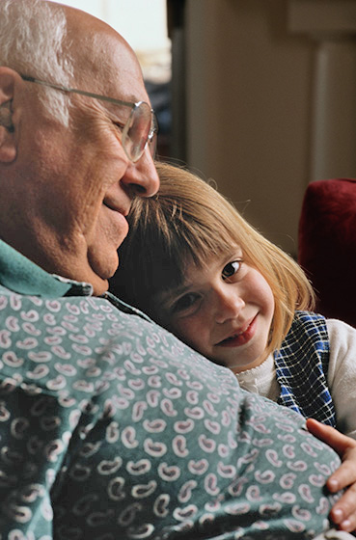
Purposes
Create a foundational understanding
Improve the quality of care and learning
Develop a more qualified workforce
Enhance the current system of services
Serve as a resource
Notes:
IELG Trainer Notes: 1 Minute
Script:
“It is important to be clear about the purposes of the Illinois Early Learning Guidelines. We cover this same content with administrators and supervisors as well as family child care and center-based providers. The Illinois Early Learning Guidelines:
Create a foundational understanding for families, providers, and professionals in the field of what children are expected to know and do across multiple developmental domains,
Improve the quality of care and learning through more intentional and appropriate practices to support development from birth to three,
Develop a more qualified workforce,
Enhance the current system of early childhood services, and
Serve a resource for those informing decision-makers involved with developing and implementing policies for children this age.
Further, the Illinois Early Learning Guidelines create from birth, an alignment of standards with existing standards and practices for older children.”
Instructions:
Ask the group if they have any comments or questions so far about the development or purposes of the guidelines from birth to three.

Slide 11
Beliefs about Children and Development
“Children are actually growing and learning in all areas of development at all times” (pg.2)
Early relationships are most important and central to young children’s development.
Development occurs across multiple and interconnected domains.
Children develop in the context of their family, culture and community.
Play is the most meaningful way children learn and master new skills.
Notes:
IELG Trainer Notes: 2 minutes
Instructions:
Read this slide, pausing to note how much of these we already know and isn’t really new as scripted below. Note that the quote is from page 2 of the Illinois Early Learning Guidelines book.
Script:
Note that what is significant is the recognition of the vital importance of the first three years to developing future capacity for learning. Birth to three is not singularly about only health and safety anymore. Birth to three providers lay an intentional, formal foundation for future learning. The Illinois Early Learning Guidelines helps us take what we know about relationships, development, children and play to a new level of being intentional in our planning to encourage parents to make the most of these interactions.
As home visitors, we want to be sure that our work with parents and their child, is not in isolation of other significant family members. This is a shared experience.”

Slide 12
What the Guidelines are not
Not a curriculum
Not an assessment tool or developmental screening
Not an exhaustive resource of child development
Not a developmental checklist
Notes:
IELG Trainer Notes: 4 minutes
Instructions:
Be prepared to manage your time with this slide as you may find that you will need to a lot more time because of the additional activity at the end of these notes. You may decide to collect unanswered questions for follow-up or integrate participant answers as the training progresses.
Script:
“We started with a review of the purposes of the Illinois Early Learning Guidelines. Let’s look next at what the Guidelines are not intended to be.
The Illinois Early Learning Guidelines is not a curriculum. Your program probably has a curriculum which may be aligned with the Illinois Early Learning Guidelines or soon will be. If you are looking for one you want to change, check to see if the curriculum you are considering IS aligned. The Illinois Early Learning Guidelines is a great resource of specific ways your staff can enhance the developmental support of family support plans, home visiting activities and instruction they already have in place. The Illinois Early Learning Guidelines will fit together with whatever program model and curricula being used in your program.
The Guidelines is not an assessment tool or developmental screening. What are some of the tools your program is already using that serve to assess for emerging developmental delays or other interruptions in normal development? (get some examples from the group) The Illinois Early Learning Guidelines should not be used for these purposes.
The Guidelines are not an exhaustive or complete resource of child development, but rather a tool that clearly lays out the benchmarks for development across a continuum of domains and gives practical instruction and ideas for how program staff can increase the learning value of interactions with parents and children. Many of these strategies for interactions can be shared with parents during home visits and in center-based settings.
Finally, the Guidelines is not a developmental checklist. The Illinois Early Learning Guidelines present development as a dynamic process recognizing that all children develop at different rates in different domains. This is a very practical resource for providers to guide their intentional planning for developmentally enriched experiences.”
Instructions: (At this point forecast that there is a flow chart in the Resource Toolkit that shows the practical integration of the use of the guidelines in home and center-based work and the relationship of the Illinois Early Learning Guidelines to the other tools and resources they already use.)
Activity:
Proceed with a Question & Answer session on the content that has been covered to this point in the training (Learning Objective 1).
Ask: “Given what we have covered so far, what are some of the opportunities you see in your role as a home visitor to support the use of the Illinois Early Learning Guidelines?”
Instructions:
Be prepared to supplement your groups’ ideas with examples of a home visiting nature.

Slide 13
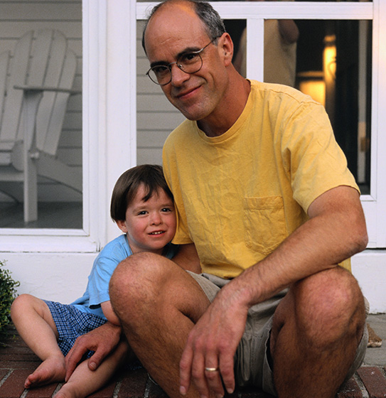
Early Learning Guidelines in Action!
A look inside at ‘How to Use the Guidelines’
Activity 1: Features of the Sections
Activity 2: Use of the Guidelines in Home Visiting
Notes:
IELG Trainer Notes: 1 minute
Script:
“At this point we are ready to get into the Illinois Early Learning Guidelines, and the information that relates to learning objectives 2 and 3 of our training. Those are to:
Develop a working knowledge of the Illinois Early Learning Guidelines, resources and toolkit.
Develop plans for the implementation of the Guidelines in planning and interactions with parents and their children.
To start this process, we are going to do two activities to become oriented to the features of the Guidelines so we can begin to think practically about how to use them in home settings.
Activity 1 highlights features of the sections that describe how the Guidelines are laid out, followed by Activity 2, which addresses terminology frequently used with parents in our work with their families through home visiting. But first, let’s take a look at the section in the Illinois Early Learning Guidelines where this information used for these the activities will come from.”

Slide 14
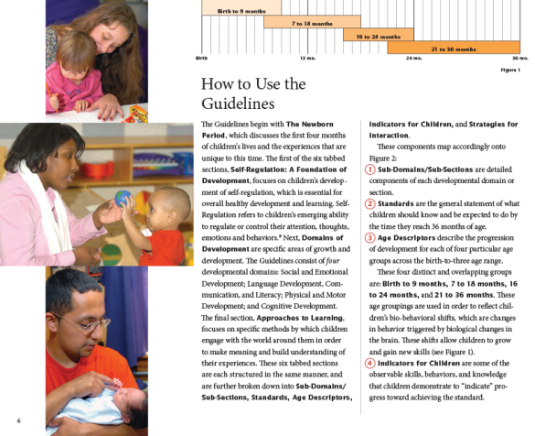
How to Use the Guidelines (see page 6)
Notes:
IELG Trainer Notes: 1 minute
Instructions:
Make sure the Illinois Early Learning Guidelines book has been distributed so that there is at least one book for each group. Ask the everyone to turn to page 6 in the IELG.
Script:
“Page 6 has some of the definitions that will be a part of Activity 1, including:
Sub-Domains/Sub-Sections
Standards
Age Descriptors, and
Indicators for Children.
This activity will help you to navigate the Illinois Early Learning Guidelines with greater ease.”

Slide 15
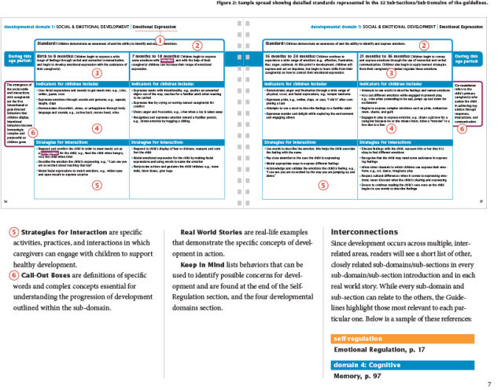
How to Use the Guidelines (see page 7)
Notes:
Instructions:
Next refer the group to turn to page 7.
Script:
“The purpose of working with pages 6 and 7 is to ensure that you are well-oriented to how the book is constructed for ease in routine use. It will help you have a shared understanding with your colleagues of its organization of information and use of terms.
Additional definitions on this page include:
Strategies for Interaction
Call-Out Boxes
Real World Stories and
Keep in Mind, which are a list of behaviors that can be used to identify possible concerns for development.
Pages 6 and 7 are a useful reminder of the way information is presented throughout the Guidelines. Again, this terminology will also be used in Activity 2.”

Slide 16
Activity 1 – Features Of The Sections
Pair and Share
Self-Regulation
Domains of Development
Approaches to Learning
Sub-Domains/Subsections
Standards
Age Descriptors
Indicators for Children
Strategies for Interaction
Call-Out Boxes
Real World Stories
Keep in Mind
Notes:
IELG Trainer Notes: 5 minutes
Script:
“With respect to Activity 1, this “Pair and Share” activity is used in the provider training.”
Instructions:
Ask the group to form groups of three for both Activities 1 and 2. Each group will get a slip of paper with a phrase from pages 6 and 7 of the Illinois Early Learning Guidelines on it (as noted on the slide). Each group will need to have a copy of the IELG. Ask the group to turn to page 6 and 7 in the Illinois Early Learning Guidelines.
Have the group take a few minutes to read each definition. Make sure that everyone in the group has an opportunity to see the hardcopy of the Guidelines and see exactly how the features are laid out from birth-three and across all four developmental domains.
Then read the slide and pause so that the group can reference each section as you highlight it.
Ask if there are questions at this time.
Ask if they think they think this exercise is sufficient to understand the terms or if there may be something else they may want to do to ensure their own working knowledge of pages 6 and 7.

Slide 17
Activity 2 – Use of the Guidelines in Home Visiting
Essential Components
Relationships
States of Awareness
Culture
Birth Order
Differences in Learning Abilities
Temperament
Primary Caregivers
Toxic Stress
Play
Brain Developer
Notes:
IELG Trainer Notes: 12 Minutes
Instructions:
Please note that everyone may stay in the same group of three’s and continue with Activity 2. Using the list script below, read and define the terms on the slide.
Script:
“Let’s take a minute to look at the terms on this slide. You will be familiar with many if not all of these terms. However, let’s review their significance in our work with parents and children and in the context of the Illinois Early Learning Guidelines.
Relationships: (p. 2) Early learning occurs in the context of relationships. Positive and secure relationships are the foundation for children’s healthy development in all areas and provide models for future relationships they will establish.
States of Awareness (p. 9) There are a total of six states that infants cycle through during the day.
Culture: (p. 2) Culture plays a significant role in how children develop, as it influences families’ practices, beliefs, and values for young children.
Birth Order: (p. 3) Birth order can influence children’s personality and how they relate with their family. Children each have their own unique personality traits: yet, birth order may have an impact on how children’s personality traits are expressed.
Differences in learning abilities (p. 3): all of us have preferred ways of learning such as seeing (e.g. reading), touching (putting our hands on something) hearing (listening to words, music or other sounds), etc. We need to be aware of a child’s preferred way of learning or in a group, be sure we are doing something that holds appeal to all children’s preferred way to learn.
Temperament: (p. 3) : Temperament refers to the unique personality traits that children are born with. It influences how children respond to the world around them, and how others will interact with them.
Primary Caregivers: (p. 4) those adults with whom the child spends the most time
Toxic Stress: (p. 3) Beyond the normal level of childhood stress and has a negative impact or disruption on child development. Includes the impact of abuse/neglect, community violence, extreme poverty, domestic violence and substance abuse in adults among other factors.
Play: (p. 4) Play is “the child’s work” and is the primary vehicle through which children learn and make sense of the world around them. Observing play is a primary opportunity to observe a child’s developmental progress.
Brain Developer: (p. 4) All caregivers, attachment figures, professionals and familiar figures contribute to the brain development in children birth to three. Since learning occurs primarily in the context of a relationship, young brains grow healthier through the contribution of engaged adults.
Activity 2 Instructions:
Staying in the groups of three, give each group a slip of paper with a phrase from this slide on it. Take 7 minutes to discuss these important concepts and components from the Illinois Early Learning Guidelines that is important to home visiting work with infants and young children.
Ask:
“Why are they important to the development of children birth to three?”
“How would some of this information be shared with parents?”
Ask for a comment from each group that came up in their discussion.

Slide 18
Practice!
Observe a Video Vignette
Documentation of facts: that are seen, heard, or done
Refer to the Illinois Early Learning Guidelines
Reflect and Respond
Talking with Parents
Talking with Supervisor
Notes:
IELG Trainer Notes: 15 minutes
Script:
“One of the opportunities we want you to have during this training is to actually practice using the Illinois Early Learning Guidelines. So I’d like for you to get into groups of four. Please select a scribe and spokesperson who will share information out to the larger group a little later on. Next we will watch a short video of an infant learning to feed herself.

Slide 19
Observation Worksheet: IELG (O-3 Years) (see handout and sample)
Date:
Age of Child: Initials of Child or First Name:
Activity: _______________
(DOMAINS OF DEVELOPMENT: WORKSHEETS 1, 2, 3, and 4)
Notes:
IELG Trainer Notes: 2 Minutes
Instructions:
Distribute the observation worksheets. Each group receives 4 worksheets - one for each domain. Each person in their small group will focus on a sub-section. After a few minutes of small group discussion, bring the larger group back together to discuss their observations.
First, after watching the video, individually, write down the facts. We are looking for objective observations. Objective observations are descriptions of what you see and hear. Subjective observations are not what we are looking for. These would be opinions or interpretations of what you saw and heard. Only list objective observations. A worksheet has been developed for you to help get started. On each worksheet, you will document in the appropriate area, what skill or behavior you observed. There is one worksheet for each domain: Social & Emotional Development; Physical Development & Health; Language, Communication & Literacy; and Cognitive Development.
After you write down your individual observations, then discuss them in your small groups for a few minutes. Use the Illinois Early Learning Guidelines to help describe what you observed; then we will discuss the observations as a larger group.
Just a quick side note that this format of practice comes from the “Focused Teaching Cycle” that will be in your Resource Toolkit discussed later in this training. For now you will observe, reflect, and respond!”
Script:
“Let’s take the time now to discuss each worksheet that has been developed for documentation. As noted earlier there is a worksheet for each of the four developmental domains and each worksheet references the specific pages of the Illinois Early Learning Guidelines. Also keep in mind some ways to talk with parents about what you’ve observed in the video and how you might share them with your supervisor.”
Observations need to be objective, record what you see and hear. Try not to interpret the meaning of what you observe. Stick to the facts.
Think about how and when you would use them in your programs.
How would they be helpful in talking to parents, your supervisor, or in ongoing staff development meetings?”

Slide 20
Observation 1: VIDEO CLIP
“Maddie Almost 8 Months Old”
http://www.youtube.com/watch?v=d1f8b3X4uIY
Notes:
IELG Trainer Notes: 30 minutes
Video for first video activity.

Slide 21
Sample Video Observation Feedback
Vignette 1 “Maddie Almost 8 Months Old”
8 months
Domain 1
Social and Emotional Development: Birth – 9 Months – (Attachment Relationships) – Children begin to build trust, initiate interaction, and seek proximity with one (or a few) primary caregiver(s). (P. 32)
Indicators:
Responds to caregiver (s) by smiling and cooing
Imitates familiar adults’ gestures and sounds)
Strategies for Interaction:
Provide prompt, responsive, and sensitive care to the child’s needs
Follow the child’s cues; allow the child to socially disengage when ready
Domain 2
Physical Development and Health: 7- 18 Months – (Fine Motor) – Children begin to gain control of their small muscles and purposefully manipulate objects. (P. 62)
Indicators:
Picks up objects
Uses pincer grasp, e.g., picks up cheerio with thumb and forefinger
Strategies for Interaction:
Provide the child with finger foods they can grasp and bring to mouth, e.g., dry cereal
Allow the child to explore books on his or her own
Notes:
IELG Trainer Notes: (3 minutes)
Script:
(After hearing feedback from the room during debrief) “Let’s take a look at this sample video feedback form from this training developer”.
What are the similarities and differences compared with what you discussed in your small groups?
Are there a couple of people who can share their information from Domains 1 and 2?
In what ways is the Illinois Early Learning Guidelines useful in providing age appropriate indicators of behavior but also strategies for interacting?
This information can be extremely useful in your work with parents and children during home visiting.”

Slide 22
Sample Video Observation Feedback (cont.)
Domain 3
Language Development, Communication, & Literacy: Birth to 9 Months – (Social Communication) - Children are participating in interactions with familiar others. Children also begin to demonstrate simple turn-taking skills while interacting. (P. 76)
Indicators:
Communicates and responds by grunting, nodding, and pointing
Uses facial expressions, vocalizations, and gestures to initiate interactions with others
Strategies for Interaction:
Use words that are found in the child’s context and culture
Name objects in the child’s environment
Domain 4
Cognitive Development: Birth to 9 Months – (Spatial Relationships) – Children use observation and sensory exploration to begin building an understanding of how objects and people move in relationship to each other. (P. 102)
Indicators:
Reaches and grasps for objects
Explores through the use of different senses, e.g., begins to mouth and / or pat objects
Strategies for Interaction:
Provide interesting and age appropriate toys and objects for exploration
Engage and interact with the child frequently during the day; follow the child’s lead during play
Notes:
IELG Trainer Notes: 8 minutes comprised of: 3 minutes of observation feedback and 5 minutes summarizing.
Instructions:
Again, ask for similarities or differences in observational feedback. Ask a couple of individuals to share from their small group discussions about Domains 3 and 4.
Please notice that the END OF THIS SLIDE SHOULD BE 2 HOURS. It’s also important to note here that if this is a 2-hour training after a few minutes of discussion around the observation, summarize & close the 2-hour training and invite them back for Part 2 of the Home Visitor Training. You should have the date of the next training available and be ready to share it with your group.
If this is a 4-hour training, after you review the sample video observation feedback form for video clip one, proceed to the next slide for video clip two.
To close this video observation, ask the group and note their feedback as they answer the first question. For the second question, encourage the group to write down their thoughts that will be used as a reference later for action planning at the end of the training.

Slide 23
Observation Worksheet: IELG (O-3 Years) (see handout and sample)
Date:
Age of Child: Initials of Child or First Name:
Activity: _______________
(DOMAINS OF DEVELOPMENT: WORKSHEETS 1, 2, 3, and 4)
Notes:
IELG Trainer Notes: 4 Minutes (Video clip 2 is 3 Minutes. “My Smart 18 Month Old Baby” – 18 Months)
Instructions:
Distribute the observational feedback forms. Each participant gets 1 developmental domain sheet (each person is to focus on a sub-domain within each group.) Each group should have access to the Illinois Early Learning Guidelines after they document their observations.
Let everyone know that after about 15 minutes, there will be a discussion of their feedback with the larger group.

Slide 24
Observation 2: Video Clip
“My Smart 18
Month Old Baby”
http://www.youtube.com/watch?v=N3PBjecBtos
Notes:
IELG Trainer Notes: 4 Minutes (Video clip is 3 minutes “My Smart 18 Month Old Baby” – 18 Months)
Video for second video activity.

Slide 25
Sample Video Observation Feedback
Vignette 2 “My Smart 18 Month Old Baby”
Domain 1
Social & Emotional Development: Attachment Relationships – 16-24 Months - Children begin to use nonverbal and verbal communication to connect and reconnect with their attachment figure.
Indicators for Children:
Actively seeks emotional responses from caregiver (s) by waving, hugging, and crying
Plays physically away from primary caregiver with increasing confidence; moves closer as needed
Strategies for Interaction:
Provide ample opportunities for play and interaction with nurturing adults
Respond to the child’s attempts to seek out a response, e.g., blow a kiss back after the child blows a kiss
Domain 2
Physical Development & Health – Perceptual – 7-18 Months - Children begin to use sensory information received from their environment to alter the way they interact and explore.
Indicators for Children:
Begins to manipulate materials
Begins to show preference for or aversion to particular activities
Strategies for Interaction:
Provide the child with choices for experimenting with sensory objects
Expose the child to different textures, smells, sounds, and sights
Notes:
IELG Trainer Notes: 4 Minutes (Video Clip is 1:54 minutes “My Smart 18 Month Old Baby” – 18 Months)
Script:
(After hearing feedback from the room during debrief) “Again, let’s take a look at this sample video feedback form in context with the Illinois Early Learning Guidelines.
What are the similarities and differences compared with what you discussed in your small groups?
Are there a couple of people who can share their information from Domains 1 and 2?”

Slide 26
Sample Video Observation Feedback (cont.)
Domain 3
Language Development, Communication, & Literacy – 16-24 Months – Social Communication - Children increase their capacity for complex interactions as they use a greater number of words and actions, in addition to better understanding the rules of conversational turn-taking.
Indicators for Children include:
Initiates and engages in social interaction with simple words and actions
Pays attention to the person communicating for a brief period of time
Strategies for Interaction:
Describe the child’s play,
Listen and respond to what the child is communicating
Domain 4
Cognitive Development: 16-24 Months- Quantity & Numbers - Children demonstrate awareness of quantity, counting, and numeric competence.
Indicators for Children:
Uses nonverbal gestures to demonstrate understanding of quantities, e.g. , holds up two fingers to express two of something
Begins to use "one", "two", and "three" to identify very small quantities without counting them
Strategies for Interaction:
Use teachable moments, e.g., ask the child to pass you one crayon from the pile during art
Use numerical concepts in everyday activities, e.g., “ Would you like one cracker or two?”
Notes:
IELG Trainer Notes: 8 Minutes (A lot 3 minutes for observation feedback and 5 minutes for the summary.)
Instructions:
Reflecting the same process as previous activity (the previous slide), continue to discuss Domains 3 and 4. Ask three volunteers to share similarities and differences from their small group discussion.

Slide 27
Guidelines in Action Summary
Observation of young children’s development is critical in home visiting programs
Document behavior of the child or groups of children
Utilize resources available
Practice Makes Better…A better opportunity for young children to become successful contributors to our workforce and society!
Notes:
IELG Trainer Notes: 5 Minutes
Instructions:
Please read the following while showing this slide:
Script:
“Practice using the Illinois Early Learning Guidelines with a hands-on approach in planning home visits and with parents on home visits.
Observations are emphasized as a critical component of working with young children. The more you observe, it gives you a richer experience in working with young children and sharing this information with parents.
Document behavior and if appropriate, take a picture of unique behavior that demonstrates progress in a particular domain. A picture says a lot.
Utilize resources that also may include talking with peers, a supervisor, colleagues, and parents about the richness of information found in the Illinois Early Learning Guidelines; and finally,
Practice Makes Better. We are actively providing a better opportunity for young children to become successful contributors to our workforce and society!”

Slide 28
The IELG and Resource Toolkit
Illinois Early Learning Guidelines
Flow Chart for Implementation of the IELG
Focused Teaching Cycle
Observation Documentation
Notes:
IELG Trainer Notes: 15 minutes
Instructions:
Instruct everyone to open up the Resource Toolkit and other resources list in their Participant’s Guide. Walk through the Table of Contents in the Toolkit with them so they know what is in it.
Script:
“A Resource Toolkit is provided in the Participant’s Guide for providers attending training. Let’s take a look at the Toolkit and other resources you have to take back with you to your program.
None of the materials are “required” but may help to advance your practice and thinking in practical ways. Also, note that not all of the materials and tools will apply to your program. Refer them to talk with you or their technical assistance provider if they have questions.
Illinois Early Learning Guidelines – There are many ways to use this in your program (such as developing goals and observing parent – child interactions).
Flow Chart – discuss using the guideline in planning, or after making specific observations.
Focused Teaching Cycle – Two ways to use this in your program (weekly home visits and observing parent-child interactions);
Documentation – Observational Worksheets (Developmental Domain worksheet (4); Self-Regulation & Domain worksheet; scenario practice worksheet; individual child worksheet).
What else is a helpful resource for you?

Slide 29
Your Action Plan!
IMPLEMENTATION
STRATEGIES
Notes:
IELG Trainer Notes: 20 minutes.
Script:
“Over the past 4 hours, we have shared information on the history, creation and development of the Illinois Early Learning Guidelines and spent much of our time “practicing” or using a hands-on-approach in how to implement the Guidelines.
How can you use them to be more intentional about sharing your observations with families using the Illinois Early Learning Guidelines as a framework?
These observations can be useful when you speak with parents, in team meetings, in supervision, and in developing Individual Family Support Plans (IFSP). You have likely already started thinking about how to use the Guidelines in practice.
So please take about 20 minutes to work on your action plan.”
Instructions:
Hand out an action plan sheet and have individuals work in groups of four. Review the form with the group and give some examples of the kinds of things to list. Announce that they will have 15 minutes to complete the form.
Move through the room and listen to what is being said…offer support as indicated. In the last 5 minutes ask for a volunteer or two to share something that they plan to do that would be a new routine for them.

Slide 30
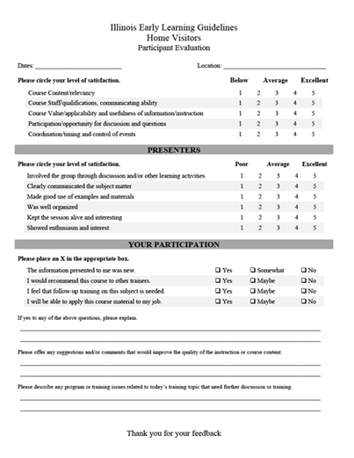
Reflection and Evaluation
Notes:
IELG Trainer Notes: 15 minutes
Instructions:
Ensure that you have a place to collect completed evaluation forms. When you ask the two questions below, ask people to share and share your own thoughts about what you will remember about this group and the time you spent with them. Share your own thoughts about what you wish there was more time to explore.
Script:
“As we are closing our time together, please complete the training evaluation form. Your feedback will be used to improve and inform changes needed to make this learning experience more effective.
During our last few minutes together, I’m interested to hear your thoughts about the 4-hour session. Specifically,
What do you think you will remember most about this session a week from now?
If we had more time together, what would you want to do in that time?
Thank you for your attendance and participation.
Instructions:
Show the last slide.

Slide 31
THANK YOU FOR YOUR PARTICIPATION!!!!
Notes:
IELG Trainer Notes: Last slide for saying goodbye.
Instructions:
Be sure to let attendees know where they can contact you or their training/technical assistance provider to get more information and technical assistance.
Collect the evaluation forms.

