Slide 1
ILLINOIS
EARLY LEARNING
GUIDELINES For Home Visitors
WELCOME!

Slide 2
IELG Agenda
Welcome and Introductions
Illinois Standards Orientation
Introduction to the Illinois Early Learning Guidelines (IELG)
IELG in Action
Practice!
Guidelines in Action Summary
Resource Toolkit
Action Plan
Reflection and Evaluation

Slide 3
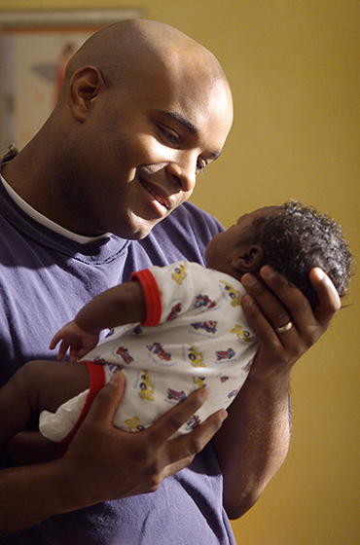
Introductions Activity
Name
Role
Identify a wish you have for the future of a child between the ages of birth to three and their family.

Slide 4
Learning Objectives
As a result of participation in this 4-hour training, home visitors will:
Become aware of the history, purpose and role of the Illinois Early Learning Guidelines in the context of Illinois Learning Standards.
Develop a working knowledge of the Illinois Early Learning Guidelines, and Resource Toolkit.
Develop plans for the implementation of the Illinois Early Learning Guidelines in planning and daily routines of interaction with children and families.

Slide 5
Illinois Standards Orientation
Birth – Grade 12
http://youtu.be/GndC_UQ-TnA

Slide 6
Introduction to the Illinois Early Learning Guidelines
History and Development
Purposes
Beliefs about Children and Development
What the Guidelines are not

Slide 7
History and Development of Guidelines
Statewide Collaboration
Illinois Early Learning Council
Infant Toddler Committee
IELG Work Group
IELG Domain Writing Team

Slide 8
Purposes
Create a foundational understanding
Improve the quality of care and learning
Develop a more qualified workforce
Enhance the current system of services
Serve as a resource

Slide 9
Beliefs about Children and Development
“Children are actually growing and learning in all areas of development at all times” (pg.2)
Early relationships are most important and central to young children’s development.
Development occurs across multiple and interconnected domains.
Children develop in the context of their family, culture and community.
Play is the most meaningful way children learn and master new skills.

Slide 10
What the Guidelines are not
Not a curriculum
Not an assessment tool or developmental screening
Not an exhaustive resource of child development
Not a developmental checklist

Slide 11
Early Learning Guidelines in Action!
A look inside at ‘How to Use the Guidelines’
Activity 1: Features of the Sections
Activity 2: Use of the Guidelines in Home Visiting

Slide 12
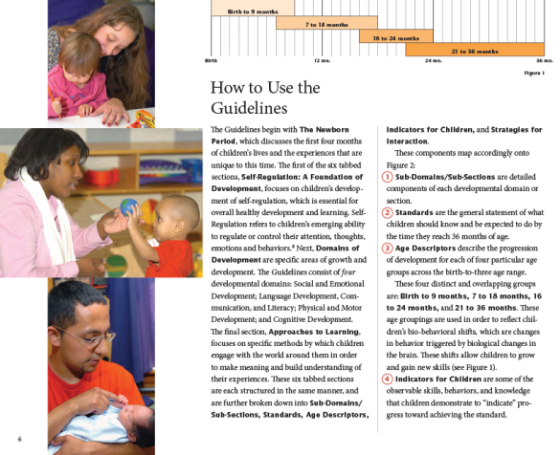
How to Use the Guidelines (see page 6)

Slide 13
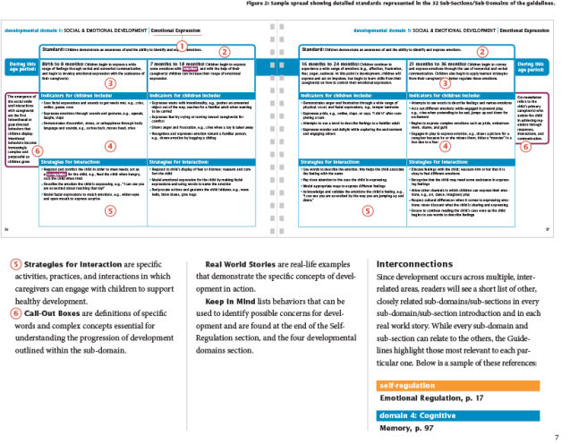
How to Use the Guidelines (see page 7)

Slide 14
Activity 1 – Features Of The Sections
Pair and Share
Self-Regulation
Domains of Development
Approaches to Learning
Sub-Domains/Subsections
Standards
Age Descriptors
Indicators for Children
Strategies for Interaction
Call-Out Boxes
Real World Stories
Keep in Mind

Slide 15
Activity 2 – Use of the Guidelines in Home Visiting
Essential Components
Relationships
States of Awareness
Culture
Birth Order
Differences in Learning Abilities
Temperament
Primary Caregivers
Toxic Stress
Play
Brain Developer

Slide 16
Practice!
Observe a Video Vignette
Documentation of facts: that are seen, heard, or done
Refer to the Illinois Early Learning Guidelines
Reflect and Respond
Talking with Parents
Talking with Supervisor

Slide 17
Observation Worksheet: IELG (O-3 Years) (see handout and sample)
Date:
Age of Child: Initials of Child or First Name:
Activity: _______________
(DOMAINS OF DEVELOPMENT: WORKSHEETS 1, 2, 3, and 4)

Slide 18
Observation 1: VIDEO CLIP
“Maddie Almost 8 Months Old”
http://www.youtube.com/watch?v=d1f8b3X4uIY

Slide 19
Sample Video Observation Feedback
Vignette 1 “Maddie Almost 8 Months Old”
8 months
Domain 1
Social and Emotional Development: Birth – 9 Months – (Attachment Relationships) – Children begin to build trust, initiate interaction, and seek proximity with one (or a few) primary caregiver(s). (P. 32)
Indicators:
Responds to caregiver (s) by smiling and cooing
Imitates familiar adults’ gestures and sounds)
Strategies for Interaction:
Provide prompt, responsive, and sensitive care to the child’s needs
Follow the child’s cues; allow the child to socially disengage when ready
Domain 2
Physical Development and Health: 7- 18 Months – (Fine Motor) – Children begin to gain control of their small muscles and purposefully manipulate objects. (P. 62)
Indicators:
Picks up objects
Uses pincer grasp, e.g., picks up cheerio with thumb and forefinger
Strategies for Interaction:
Provide the child with finger foods they can grasp and bring to mouth, e.g., dry cereal
Allow the child to explore books on his or her own

Slide 20
Sample Video Observation Feedback (cont.)
Domain 3
Language Development, Communication, & Literacy: Birth to 9 Months – (Social Communication) - Children are participating in interactions with familiar others. Children also begin to demonstrate simple turn-taking skills while interacting. (P. 76)
Indicators:
Communicates and responds by grunting, nodding, and pointing
Uses facial expressions, vocalizations, and gestures to initiate interactions with others
Strategies for Interaction:
Use words that are found in the child’s context and culture
Name objects in the child’s environment
Domain 4
Cognitive Development: Birth to 9 Months – (Spatial Relationships) – Children use observation and sensory exploration to begin building an understanding of how objects and people move in relationship to each other. (P. 102)
Indicators:
Reaches and grasps for objects
Explores through the use of different senses, e.g., begins to mouth and / or pat objects
Strategies for Interaction:
Provide interesting and age appropriate toys and objects for exploration
Engage and interact with the child frequently during the day; follow the child’s lead during play

Slide 21
Observation Worksheet: IELG (O-3 Years) (see handout and sample)
Date:
Age of Child: Initials of Child or First Name:
Activity: _______________
(DOMAINS OF DEVELOPMENT: WORKSHEETS 1, 2, 3, and 4)

Slide 22
Observation 2: Video Clip
“My Smart 18
Month Old Baby”
http://www.youtube.com/watch?v=N3PBjecBtos

Slide 23
Sample Video Observation Feedback
Vignette 2 “My Smart 18 Month Old Baby”
Domain 1
Social & Emotional Development: Attachment Relationships – 16-24 Months - Children begin to use nonverbal and verbal communication to connect and reconnect with their attachment figure.
Indicators for Children:
Actively seeks emotional responses from caregiver (s) by waving, hugging, and crying
Plays physically away from primary caregiver with increasing confidence; moves closer as needed
Strategies for Interaction:
Provide ample opportunities for play and interaction with nurturing adults
Respond to the child’s attempts to seek out a response, e.g., blow a kiss back after the child blows a kiss
Domain 2
Physical Development & Health – Perceptual – 7-18 Months - Children begin to use sensory information received from their environment to alter the way they interact and explore.
Indicators for Children:
Begins to manipulate materials
Begins to show preference for or aversion to particular activities
Strategies for Interaction:
Provide the child with choices for experimenting with sensory objects
Expose the child to different textures, smells, sounds, and sights

Slide 24
Sample Video Observation Feedback (cont.)
Domain 3
Language Development, Communication, & Literacy – 16-24 Months – Social Communication - Children increase their capacity for complex interactions as they use a greater number of words and actions, in addition to better understanding the rules of conversational turn-taking.
Indicators for Children include:
Initiates and engages in social interaction with simple words and actions
Pays attention to the person communicating for a brief period of time
Strategies for Interaction:
Describe the child’s play,
Listen and respond to what the child is communicating
Domain 4
Cognitive Development: 16-24 Months- Quantity & Numbers - Children demonstrate awareness of quantity, counting, and numeric competence.
Indicators for Children:
Uses nonverbal gestures to demonstrate understanding of quantities, e.g. , holds up two fingers to express two of something
Begins to use "one", "two", and "three" to identify very small quantities without counting them
Strategies for Interaction:
Use teachable moments, e.g., ask the child to pass you one crayon from the pile during art
Use numerical concepts in everyday activities, e.g., “ Would you like one cracker or two?”

Slide 25
Guidelines in Action Summary
Observation of young children’s development is critical in home visiting programs
Document behavior of the child or groups of children
Utilize resources available
Practice Makes Better…A better opportunity for young children to become successful contributors to our workforce and society!

Slide 26
The IELG and Resource Toolkit
Illinois Early Learning Guidelines
Flow Chart for Implementation of the IELG
Focused Teaching Cycle
Observation Documentation

Slide 27
Your Action Plan!
IMPLEMENTATION
STRATEGIES

Slide 28
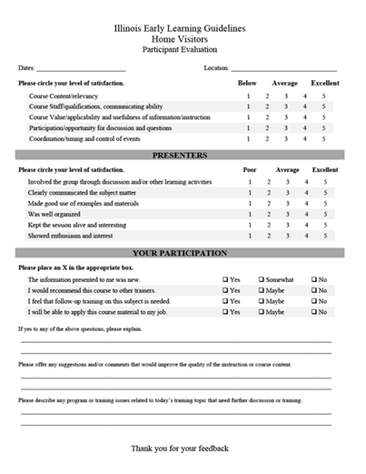
Reflection and Evaluation

Slide 29
THANK YOU FOR YOUR PARTICIPATION!!!!

